Slide 1

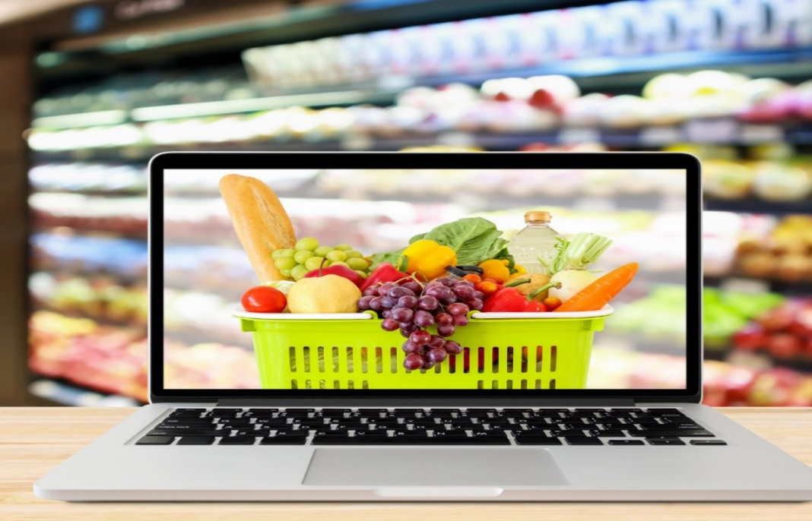
COMPUTER SCIENCE AND ENGINEERING GROCERY WEBSITE
KRISHNASAMY COLLEGE OF ENGINEERING AND TECHNOLOGY
Submited By
A. Sivajothi(421320104043)
S. Pavithra(421320104025)
M. Sasikala(421320104038)
B. Santhiya(421320104034)
V. Sivathavasi(421320104044)

Slide 2
Introduction
The Grocery Website Software Requirements Specification (SRS) outlines the essential features, functionalities, and constraints of a web-based platform designed to facilitate the purchase of grocery items. This document serves as comprehensive guide for the development and maintenance of the grocery website, aiming to enhance user experience, streamline operations, and ensure data security. It defines the scope of the project, its purpose, and the key stakeholders involved, setting the foundation for a successful Grocery website implementation.

Slide 3
purpose
A grocery website exists to provide a convenient and accessible online platform for users to purchase groceries, offering a wide variety of products, time-saving options, and potential cost savings while promoting contactless and personalized shopping experiences.
The website will be designed to offer a user-friendly interface that is easy to navigate and use.

Slide 4
Hardware Requirements
Memory : 6GB
Processor type : Intel Pentium, i3, i5, i7 or Faster
Processor Speed : 1.83GHz or Faster
Swap Space : 2.1GB
Hard Disk Space : 500GB or less

Slide 5
Software requirements
Operating System : Windows 7, 10 or Linux
User Interface : HTML, CSS
Client-side Scripting : JavaScript
Programming Language : JavaScript, Java
Backend Framework : Node js
IDE : Visual Studio

Slide 6
Functional requirements
User-Management
Product-Management
Shopping Cart
Checkout
Payment and Shipping
Admin Panel

Slide 7
Non-functional Requirements
Usability
Reliability
Scalability
Security
Localization
Performance

Slide 8
Conclusion
The grocery website project aims to provide a user-friendly platform for customers to conveniently purchase their groceries online. Through a user-centric design, robust back-end infrastructure, and a comprehensive product catalog, the website offers a seamless shopping experience. With features such as secure payment options, responsive customer support, and efficient order processing, the project addresses the evolving needs of modern consumers. It is our hope that this website will not only enhance the shopping experience for customers but also contribute to the growth of the online grocery market.

Slide 9


